Slide 1

Shri Vishnu engineering college for women::Bhimavaram (Autonomous)
Traffic Sign Detection
IV B.Tech II Sem Project power point presentation
In
Computer Science and Engineering
By
1. K. V. Subbalakshmi (18B01A0573)
2. N. Pavani (18B01A0579)
3. K. Hiranmayee (18B01A0591)
4. M. Sita Varshini (18B01A05A3)
5. G. M. Sailaja (19B05A0507)
Under the guidance of
Mrs. K. Ratna Kumari
Asst. Professor
REVIEW NO: 03
Date: 12-04-2022
Department of Computer Science and Engineering Slide No: 01

Slide 2
Problem Statement
Traffic signs are an integral part of our road infrastructure. They provide critical information, sometimes compelling recommendations, for road users.
Vehicles are all set to drive along the road. As roads get denser with other vehicles, it is difficult for vehicles to identify all the traffic signs on the path.
To assist vehicles to overcome this problem we thought of implementing a machine learning model which can detect traffic signs.
Department of Computer Science and Engineering Slide No: 02

Slide 3
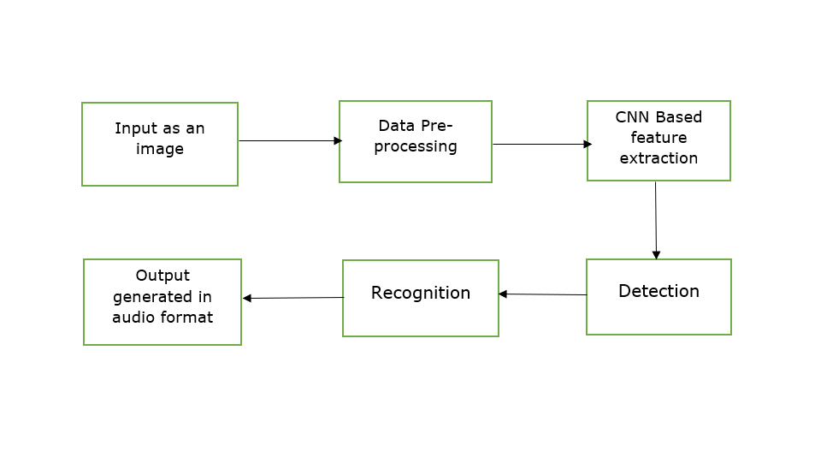
System Design
Department of Computer Science and Engineering Slide No: 03

Slide 4
Functionalities
Detects the traffic sign in the given input.
Recognizes the traffic sign.
Gives the traffic sign recognized as output in audio format.
Department of Computer Science and Engineering Slide No: 04

Slide 5
Modules
Dataset Preprocessing
Model Building
Model Training
Testing and validation
Model deployment
Department of Computer Science and Engineering Slide No: 05

Slide 6
Modules
Dataset Preprocessing: Data preprocessing is a process of preparing the raw data and making it suitable for a machine learning model. It is the first and crucial step while creating a machine learning model.
Model Building: We build a CNN model to classify the images into their respective categories.
Model Training: Model evaluation is the process of using different evaluation metrics to understand a machine learning model's performance. Various classes of images are available in the dataset for training the model.
Department of Computer Science and Engineering Slide No: 06

Slide 7
Modules
Testing and Validation: model testing is referred to as the process where the performance of a fully trained model is evaluated on a testing set. We tested the model with various inputs and we got the accuracy of 94.96 percent.
Model deployment: Deployment of the model is simply putting models into production, means making your models available to other systems. We used this model in our GUI python file for better experience of the user.
Department of Computer Science and Engineering Slide No: 07

Slide 8
Objectives Attained
Data Preprocessing: We have searched for the best dataset in order to get better results and preprocessed the data. Dataset we selected is GTSRB – German Traffic Sign Recognition Benchmark. The image dataset consists of more than 50,000 pictures of various traffic signs(speed limit, crossing, traffic signals, etc.) Around 43 different classes are present in the dataset for image classification.
Dataset Training: We split the dataset into two parts, one for training the data and other for testing the data.
Department of Computer Science and Engineering Slide No: 08

Slide 9
Objectives Attained
Model Building: We build the model using convolutional neural networks
Model Evaluation and Testing: We have tested the dataset with various inputs and we got the accuracy of 94 percent.
Model Deployment: We used this model in our GUI python file for better experience of the user. It will classify the image to which category it belongs.
Department of Computer Science and Engineering Slide No: 09

Slide 10
Results and Analysis
Input – a traffic sign image
Output – displays the traffic sign detected and the same will be read out in audio format
For example – if input traffic sign image is related to speed limit then it displays the text as speed limit with specific limit value and reads out the same
Department of Computer Science and Engineering Slide No: 10

Slide 11
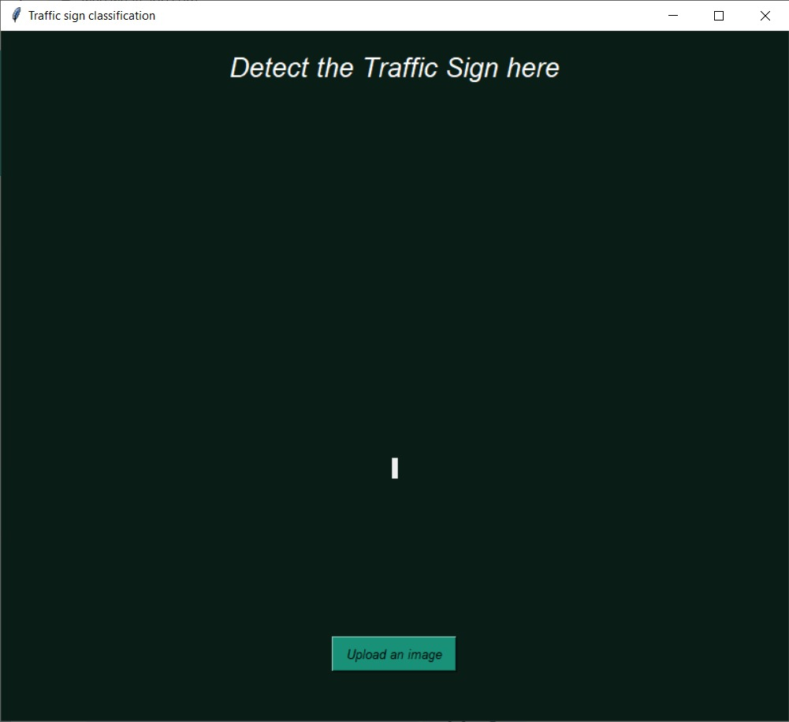
Results and Analysis
Department of Computer Science and Engineering Slide No: 11

Slide 12
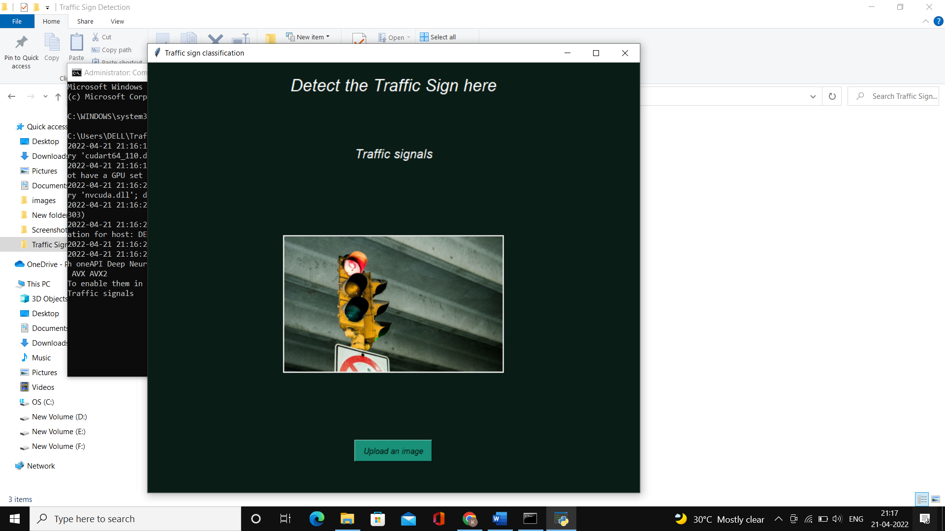
Results and Analysis
Department of Computer Science and Engineering Slide No:12

Slide 13
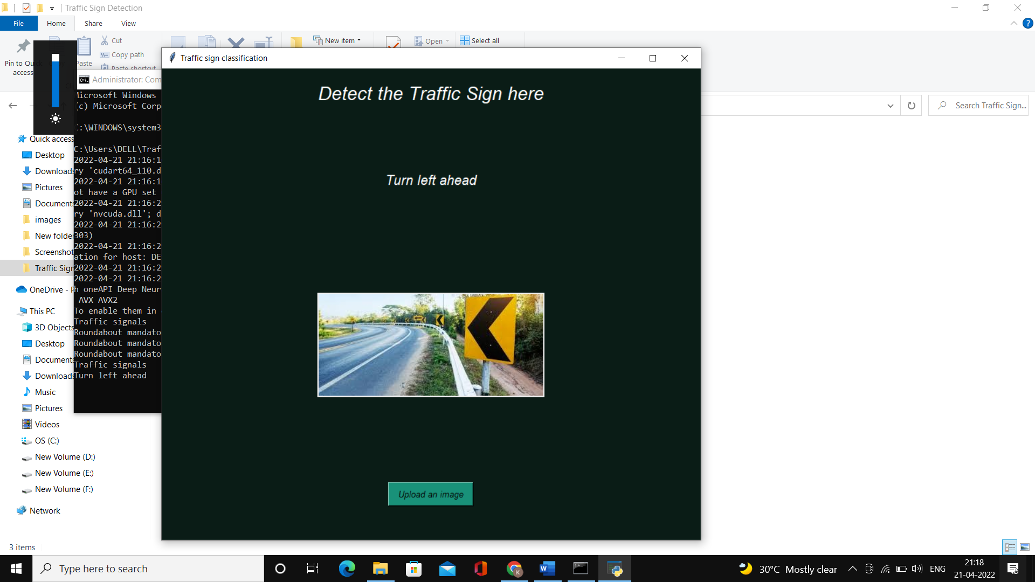
Results and Analysis
Department of Computer Science and Engineering Slide No: 13

Slide 14
THANK YOU
Department of Computer Science and Engineering Slide No: 14

